Slide 1
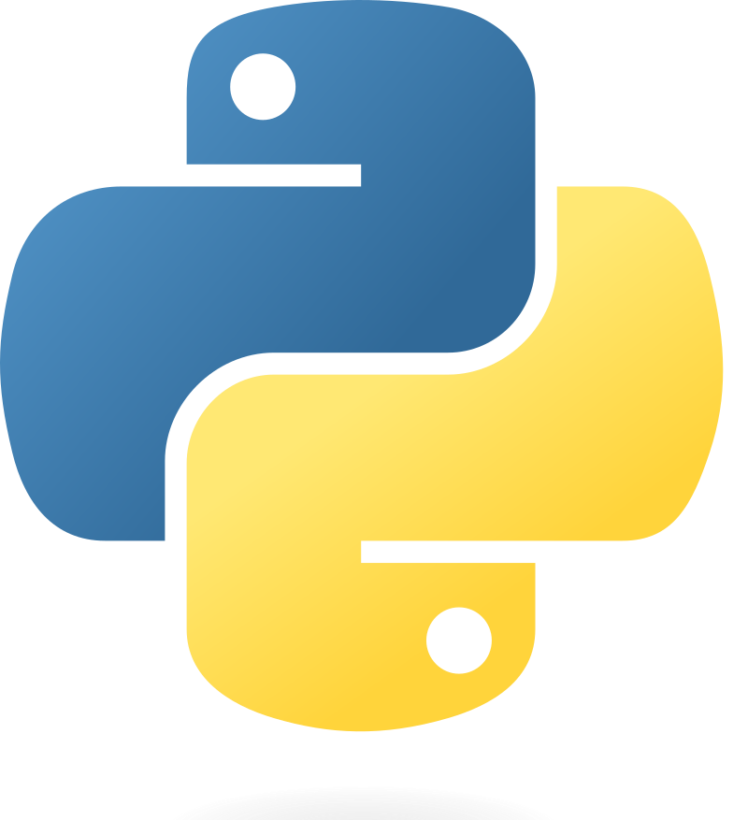
Part 1 – Software Prerequisites for Python Projects
Quang Duong

Slide 2
What We Will Learn
Software prerequisites for Python projects
Overview
What it is
What it is used for
Some major software providers for each component
Installation

Slide 3
Overview of Software Prerequisites for Python Projects

Slide 4
Software Prerequisites for Python Projects
1.
2.
3.
4.
5.

Slide 5


Software Prerequisites for Python Projects
1.
IDE
(Integrated Development Environment)
VS Code, PyCharm, …
Including
A source code editor,
Build automation tools,
A debugger,
Code completion,
Syntax highlighting,
Version control integration, etc
Allowing developers to
Write, compile, test, and debug their code within a single interface
Popular IDEs
VS Code, PyCharm, Eclipse, etc

Slide 6

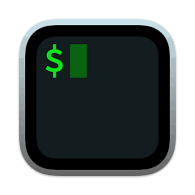
Software Prerequisites for Python Projects
1.
IDE
VS Code, PyCharm, …
2.
Terminal
PowerShell (Windows), iTerm2(Mac OS), …
Used for
Command execution
File manipulation,
Program execution,
System administration tasks
Popular terminal applications
Windows: Command Prompt, PowerShell
Linux: Bash
macOS: iTerm2

Slide 7

Software Prerequisites for Python Projects
1.
IDE
VS Code, PyCharm, …
2.
Terminal
PowerShell (Windows), iTerm2(Mac OS), …
Created by Guido van Rossum and first released in 1991
A high-level, interpreted programming language
Simplicity
Readability
Supports multiple programming paradigms
Procedural,
Object-oriented,
Functional programming.
Extensive standard library
Active community contribute to a vast ecosystem of frameworks and tools
3.
Python
Installing via: Python installer, Anaconda distributions

Slide 8
Software Prerequisites for Python Projects
1.
IDE
VS Code, PyCharm, …
2.
Terminal
PowerShell (Windows), iTerm2(Mac OS), …
3.
Python
Installing via: Python installer, Anaconda distributions
A setup where Python and its related tools and libraries are installed and configured
To develop and
Run Python applications
Popular ways to create Python environment
Virtual Environment
Using venv or virtualenv
Conda Environment
Using conda
IDE tools like PyCharm, VS Code
4.
Python environment
`venv `, `conda`

Slide 9
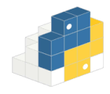
Software Prerequisites for Python Projects
1.
IDE
VS Code, PyCharm, …
2.
Terminal
PowerShell (Windows), iTerm2(Mac OS), …
3.
Python
Installing via: Python installer, Anaconda distributions
Collections of modules and functions that extend the capabilities of the Python programming language
To reuse code
To implement complex functionality without having to write it from scratch
Python Package Manager
pip, conda
4.
Python environment
`venv `, `conda`
5.
Python Packages
Pypi, Anaconda

Slide 10
Software Installation

Slide 11
Integrated Development Environment (IDE)

Slide 12
IDEs
Visual Studio Code (VS Code)
PyCharm

Slide 13
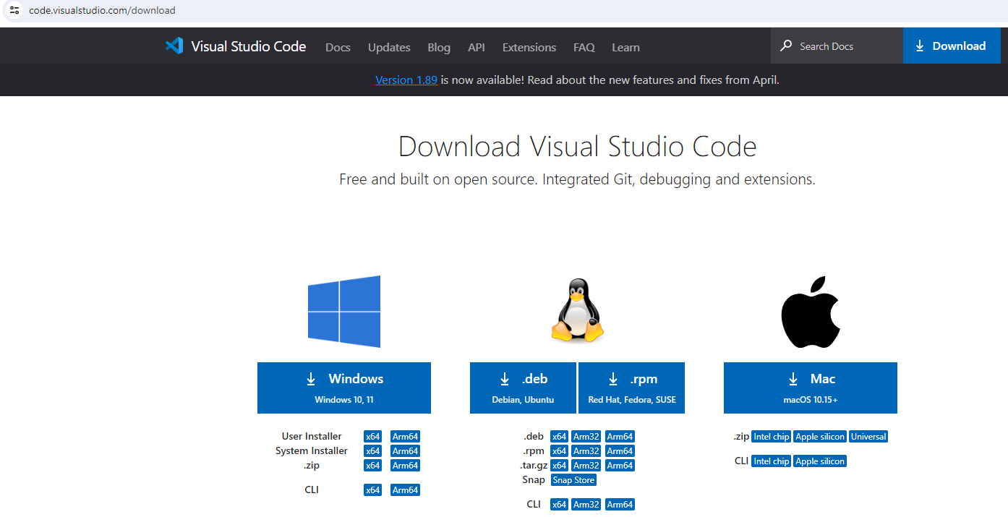
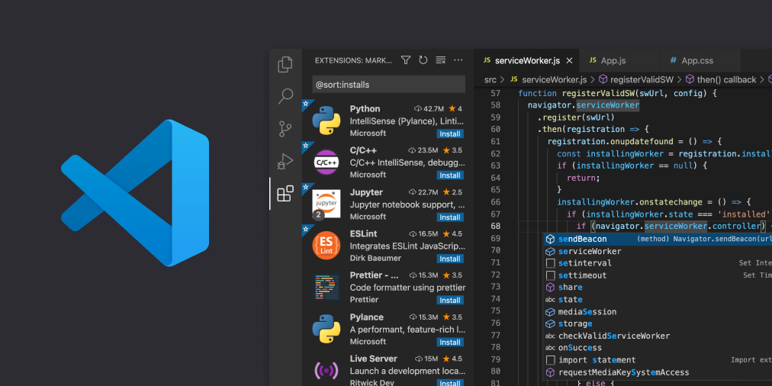
IDE - Visual Studio Code
https://code.visualstudio.com/download

Slide 14
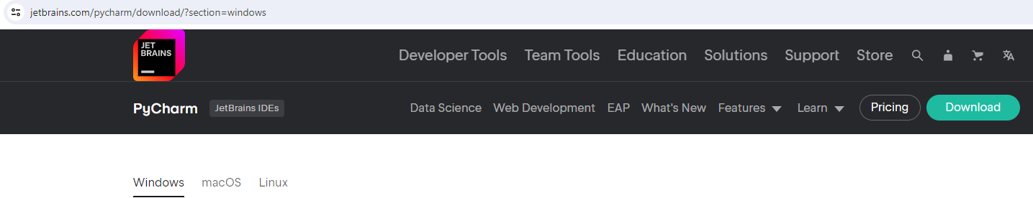
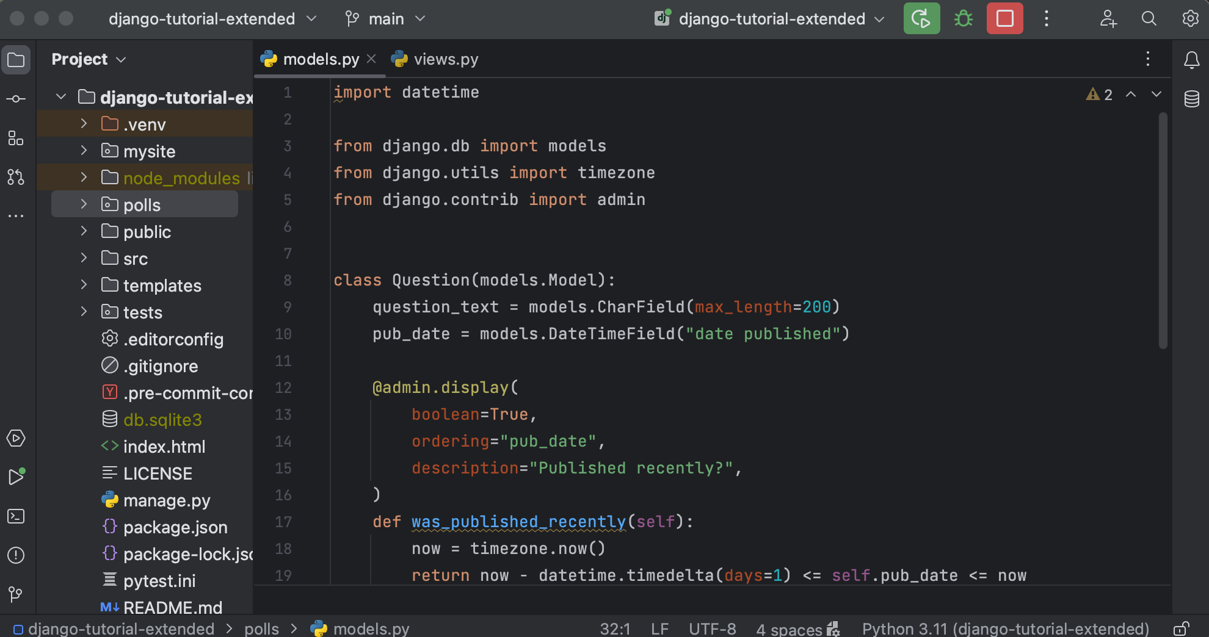

IDE - PyCharm
https://www.jetbrains.com/pycharm/download/?section=windows

Slide 15
Terminal

Slide 16
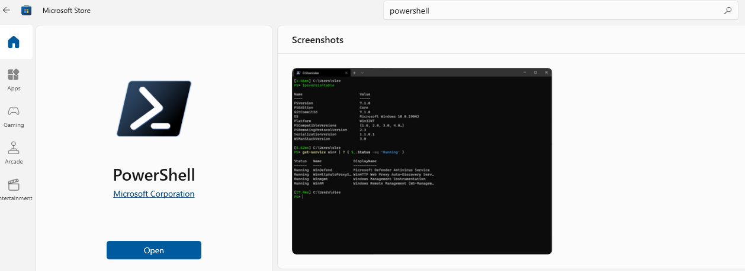
Terminal
Window: PowerShell, Command Prompt, Windows Terminal, Git Bash, WSL (Window Subsystem for Linux), …

Slide 17
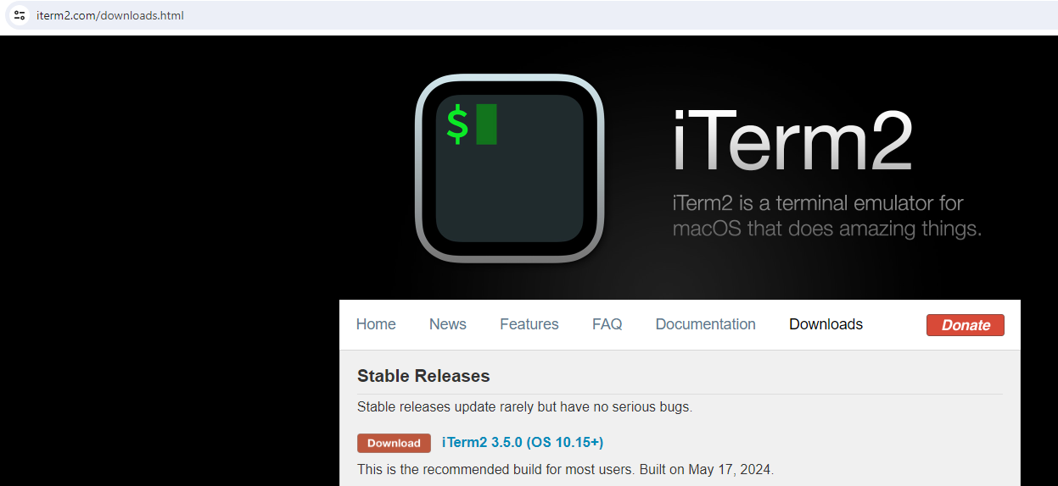
Terminal
Linux: Default terminal emulator, …
MacOS: Terminal, iTerm2 (https://iterm2.com/downloads.html), …

Slide 18
Python Installation

Slide 19
Python Installation
Via Python official page
Via Anaconda distribution

Slide 20
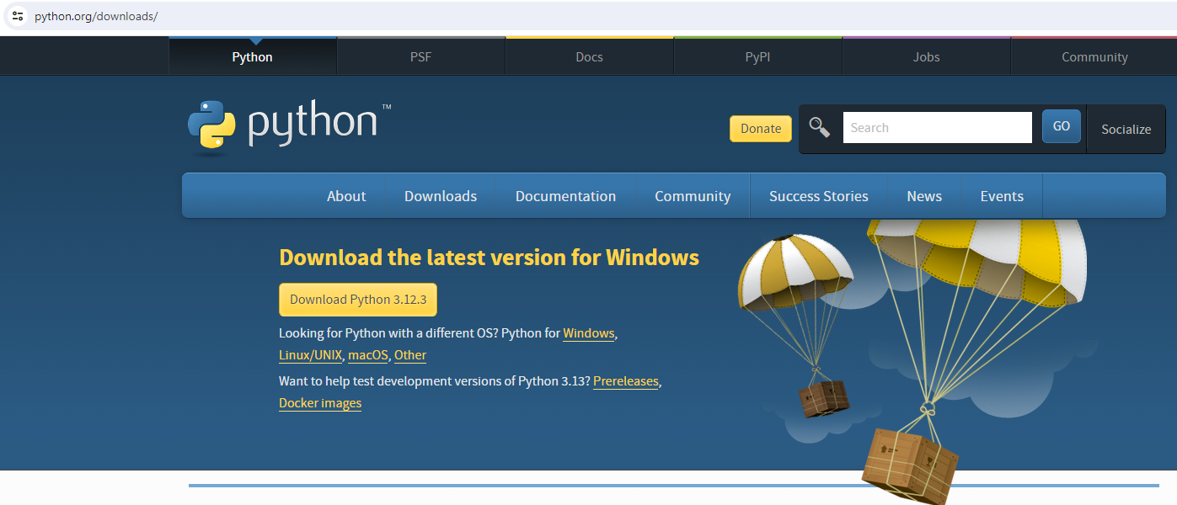
Python Installation via Official Page
https://www.python.org/downloads/

Slide 21
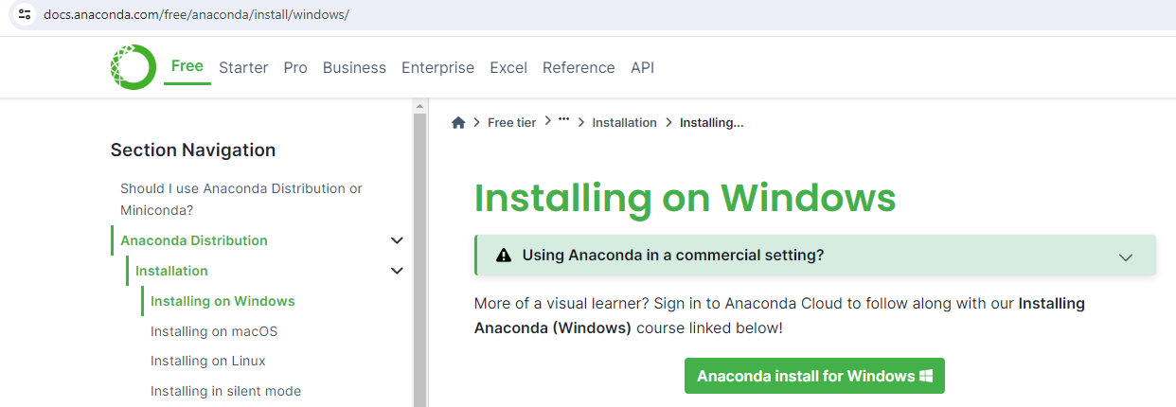
Python Installation via Anaconda
Installing Anaconda with Python included (https://docs.anaconda.com/free/anaconda/install/)

Slide 22
Python Environment

Slide 23
Set Up Python Environment
Using 'venv'
Using 'conda'

Slide 24
Set Up Python Environment with VENV
` venv `, a module included in Python 3.3 & later versions
# 1. Nagigate to the project directory
cd ./path_to_project/
# 2. Create Python environment with 'venv', e.g. named ".MY_ENV"
python -m venv .MY_ENV #(On Linux, MacOS, you may use `python3` instead of `python`)
# 3. Activate ".MY_ENV" environment
.MY_ENV\Scripts\activate # For Window
source MY_ENV/bin/activate # For Linux, MacOS
# 4. Install required Python packages and start coding. (Next slides)
… # 5. Deactivate ".MY_ENV" environment after finishing the dev
deactivate

Slide 25
Set Up Python Environment with Conda
`conda`, included with Anaconda installation
# 1. Create Python environment with `conda`, e.g. named "MY_ENV"
conda create -n MY_ENV python=3.10
# 2. Activate "MY_ENV" environment
conda activate MY_ENV
# 3. Install required Python packages and start coding. (Next slides)
… # 4. Deactivate "MY_ENV" environment after finishing the dev
conda deactivate

Slide 26
Python Package Installation

Slide 27
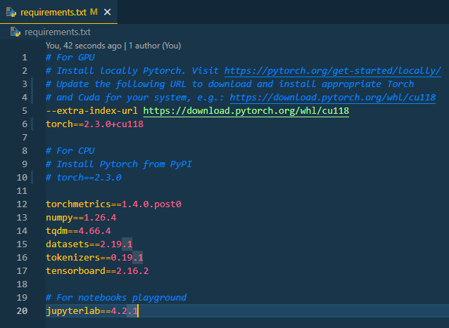
Python Package Installation
Activating Python environment
Using `pip` inside either venv or conda environment
Installing a Python package
`pip install package_name==version`
E.g. `pip install torch==2.3.0`
Installing all required packages in "requirements.txt"
`pip install –r requirements.txt`

Slide 28
What I Used in This Course

Slide 29
What I Used in This Course
IDE:
VS Code
Terminal (Windows)
PowerShell
For Python & Python Environment
conda (Anaconda)
For Python Package Installation
pip
conda create -n ENV_NAME python=3.10 conda activate ENV_NAME
pip install –r requirements.txt

